Slide 1
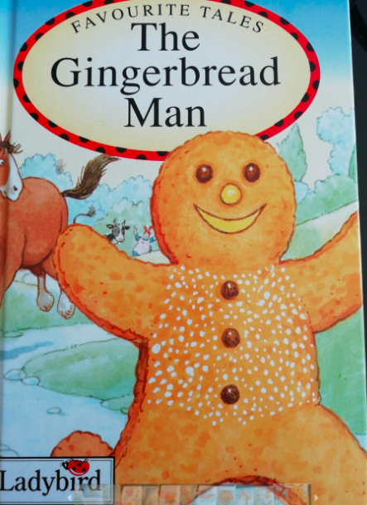
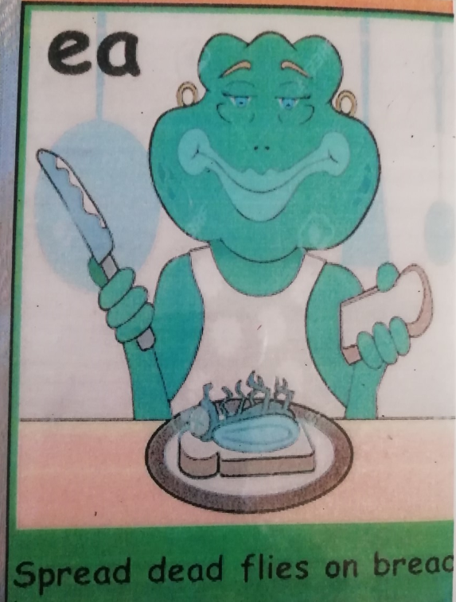
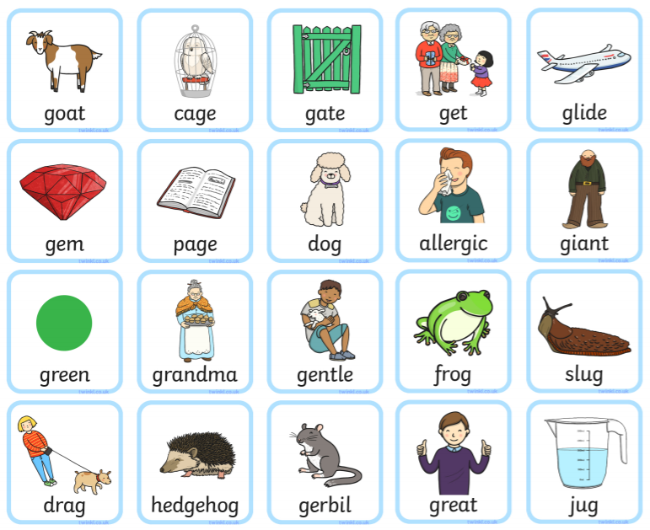
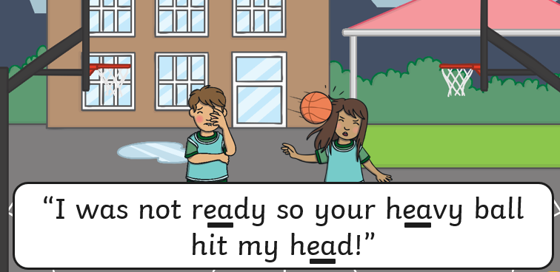
We have a new story to learn!

Slide 3
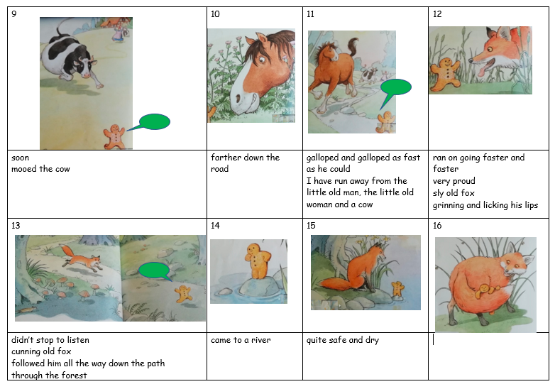

Slide 4
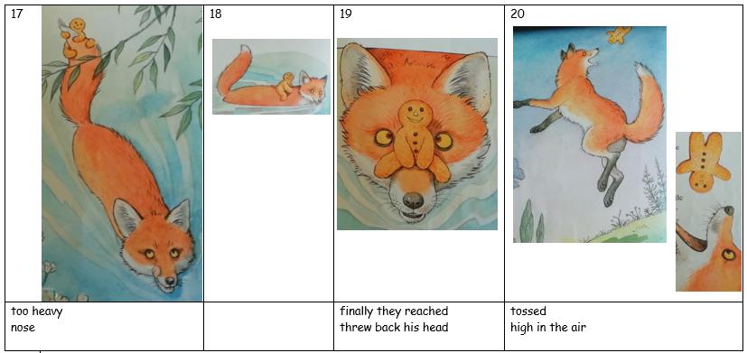

Slide 5
Assignment
For parents
The way we teach children to rapidly improve is to give them what we call a cold task before we start a new sequence of learning. It is vital that the children are given no help at all (not even a tinsy little bit!) with this task so that we know what to teach them. Please send work to us (both teachers please).
Just give them the story map without the words. This can be shown on screen below or is available as a separate downloadable document. We expect spelling mistakes and will be disappointed if we don’t get them so we know which words they need to learn to spell. Just ask the children to write the story they have just heard to the best of their ability. Go and have a cup of tea, spend time with your other children, do some of your own work or watch a bit of Good Morning! They should be able to produce the story in about 20 ish minutes although if they want to spend longer, that is fine too.
For children
You are now going to write the story as well as you can using the story map without any words. Do this without any help. This will show us what you already know and what we need to teach you.

Slide 6
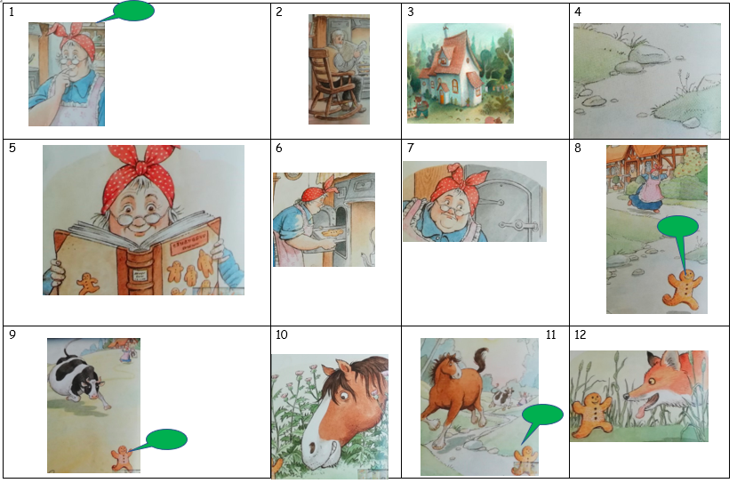

Slide 7
