Slide 1
Our school values

Slide 2
What is our new value?

Slide 3
The dragons and the giants
Giants and dragons had been enemies for years on end, but they had learned a lot. They were no longer so foolish as to wage wars with terrible battles in which thousands died. Now, every year they held bowling matches instead. A giant against a dragon. Whoever lost would become the winner’s slave. If a dragon won, he could use the giant’s muscles for all that heavy lifting. If a giant won, he would have free flights and fire for the whole year.
That is how they prevented their deaths and yet they hated each other more and more. Every year the winners were so cruel to the losers, in revenge for the times they had lost. There came a time when what mattered most was not winning the bowling match, but rather not losing.
Yonk the Giant was the best bowler, and the most afraid. He had never lost. Many dragons had been his slaves and they were dying to see him lose so they could get their revenge. This is why Yonk was terrified of losing. Especially since last year’s match, when he missed his first ever strike and decided that something had to change.
The following year he won again. When he arrived home, his slave dragon feared the worst but Yonk had a different idea in mind.
“This year you will not be my slave. We will go bowling and I will teach you all of my secrets. But you must promise me one thing: when you win your match next year, you will not be cruel to your giant. Do the same as I am doing with you.”
The dragon gladly accepted. Yonk kept his promise and he spent the entire year without flying or warming himself with the dragon’s fire breathing. The dragon also kept his promise and both did exactly the same every year afterwards. Yonk’s idea became so popular that, within just a few years, many giants and dragons were spending their days bowling together. They forgot about their battles and cruelty and treated each other as play friends rather than enemies.
Much later Yonk lost his first bowling match but he was no longer afraid of losing because, by putting a stop to the enslavement of dragons, he had ended their hatred and sowed the seeds of an almost impossible peace between giants and dragons.

Slide 11
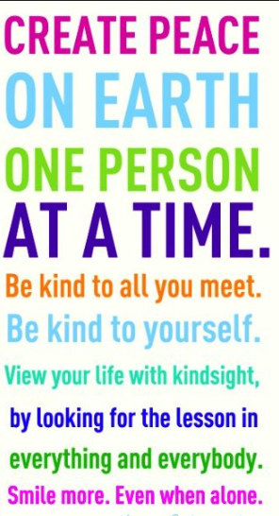
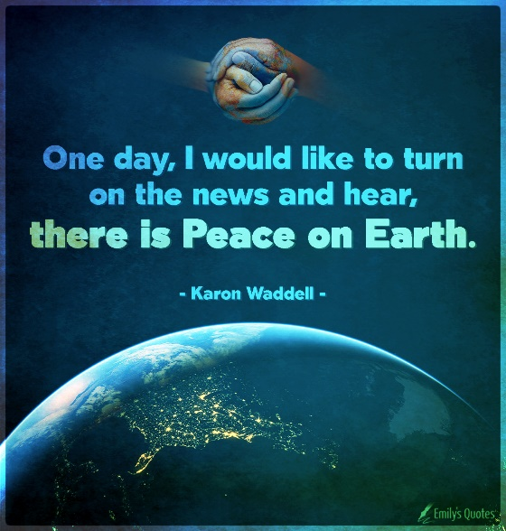
Peace

Slide 18
How can we develop inner peace?
Practise mindfulness
Practise breathing techniques
Do activities that we enjoy and help to calm us
Spend time outdoors

Slide 19
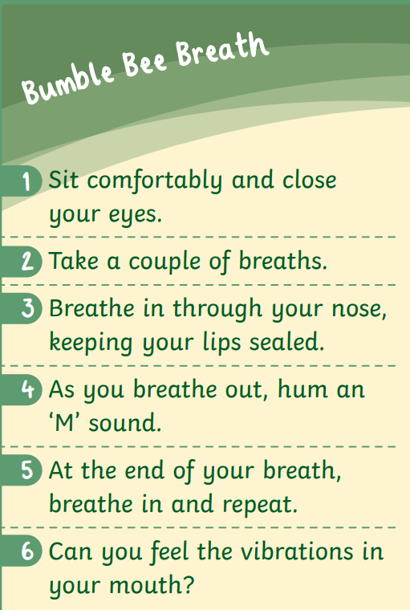
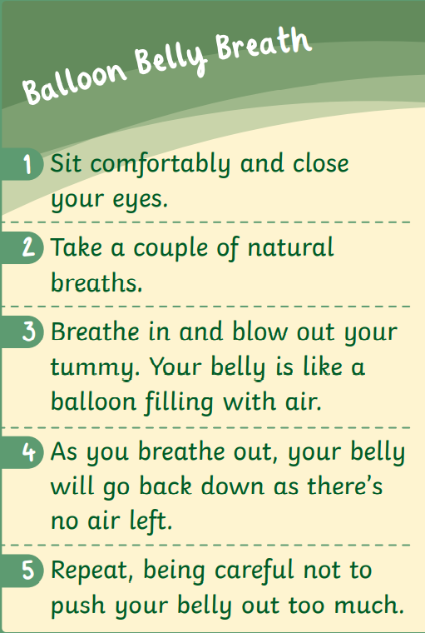
Mindful breathing

Slide 20
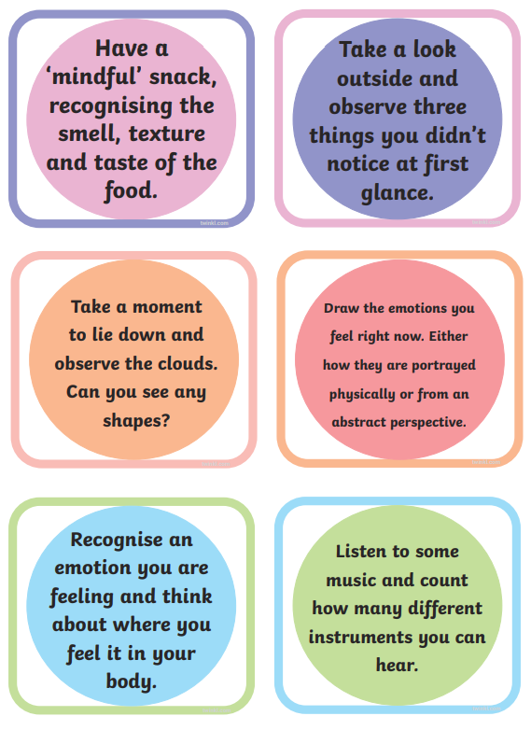
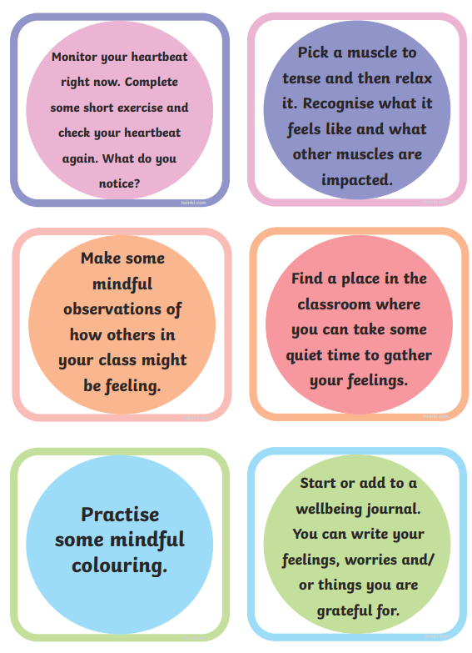
Mindful breaks

Slide 21
How can we spread peace to others?
Treat others with respect
Embrace others differences
Choose empathy instead of arguments
Encourage others to take time for themselves.

Slide 22
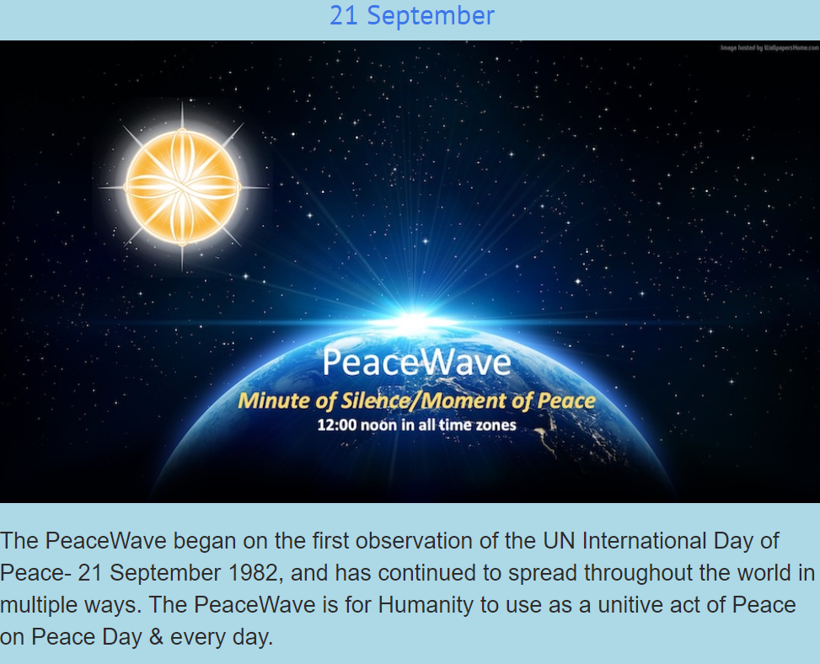
International day of peace

Slide 23
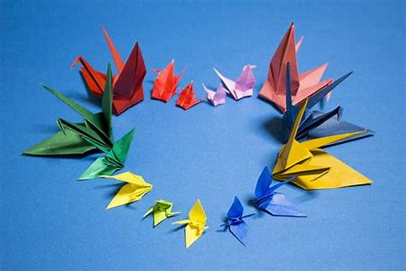
Peace challenge for September
A "peace crane" is an origami crane used as symbol of peace. The Peace Crane Project invites every student on the planet to fold an origami crane, write a message of peace on its wings, then exchange it with another student.
Your task is to create a crane (your can also create a dove or a heart) and write a message of peace. This can be a message for inner peace or world peace.
Take a picture of you giving your crane to a member of the family, another student, or someone else you know to help spread the message of peace.

